Slide 1
Course - DT228-2
Module (Subject) -
Human Computer Interaction
Semester 2, Week 10
APPLICATION AREAS

Slide 2
Overview of Lecture
Application Areas of:
Interactive Systems Development
CSCW (Computer-Supported Cooperative Work)

Slide 3
Fields that HCI builds on
…/ continued
Computer Science
Implementation of software
Engineering
Faster, cheaper equipment
Ergonomics
Design for human factors
Graphic Design
Visual communication
Technical Writing
Textual communication

Slide 4
Fields that HCI builds on (2)
Linguistics, Artificial Intelligence (AI)
Speech recognition, natural language processing
Cognitive Psychology
Perception, memory, mental models
Sociology
How people interact in groups
Anthropology
Study of people in their work settings

Slide 5
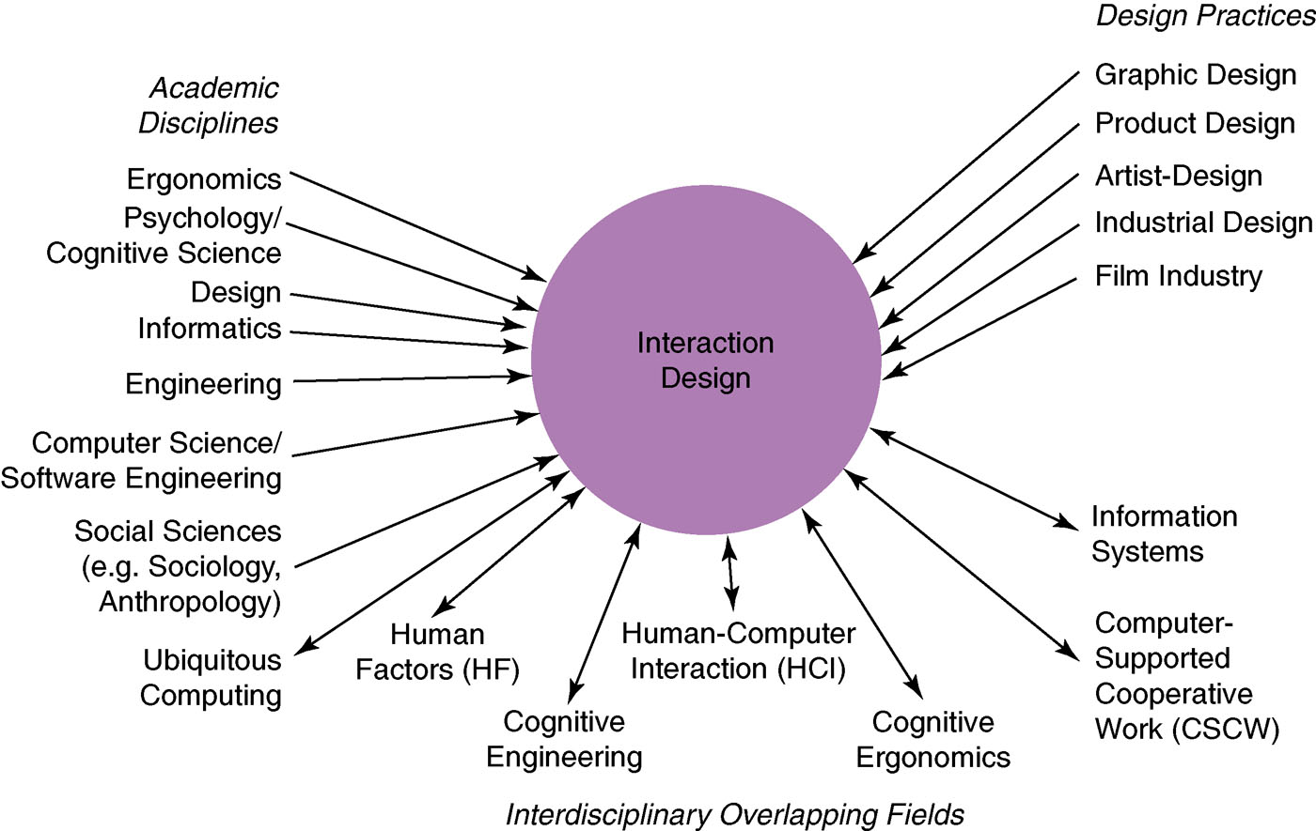
HCI and Interaction Design

Slide 6
Relationship between Interaction Design, HCI and other fields
Design practices contributing to Interaction Design include:
Graphic design
Product design
Artist-design
Industrial design
Film industry

Slide 7
Relationship between Interaction Design, HCI and other fields (2)
A reminder about the interdisciplinary fields in interaction design:
HCI
Ubiquitous Computing
Human Factors
Cognitive Engineering
Cognitive Ergonomics
Computer Supported Co-operative Work
Information Systems

Slide 8
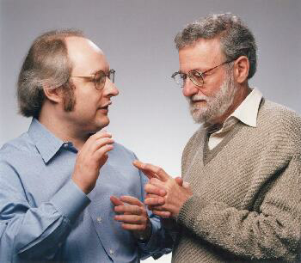



Interaction design as business
There is an increasing number of interaction design consultancies as businesses. Examples of well known ones include:
Nielsen Norman Group: “help companies enter the age of the consumer, designing human-centered products and services”
Cooper: ”From research and product to goal-related design”
Swim: “provides a wide range of design services, in each case targeted to address the product development needs at hand”
IDEO: “creates products, services and environments for companies pioneering new ways to provide value to their customers”

Slide 9
Developing Interfaces with Applications
User Interface Software Tools
Help developers design and implement user interfaces
The focus is on Tools, but these are influenced by future user interfaces
Today’s tools are highly successful
Window Managers, Toolkits, Interface Builders…
Most software is now built using them.
These tools are based on HCI research.
Future tools might be different.

Slide 10
A Historical Perspective
Interface developers have (more or less):
Addressed the useful and important aspects of interfaces
Tools that succeeded helped (just) where needed
Observed Thresholds / Ceilings
Threshold = How hard to get started
Ceiling = how much can be achieved
Used the ‘Path of Least Resistance’
Tools influence user interfaces created
Used predictability
If not predictable, then not accepted by programmers
Watched for ‘Moving Targets’
Changing user interface styles makes tools obsolete

Slide 11
Historically: What Worked?
These aspects of interface design proved valuable:
Window Managers and Toolkits
Event Languages
Graphical, Interactive Tools
Component Architectures
Scripting Languages
Hypertext
Object Oriented Programming

Slide 12
Historically: Window Managers
Multiple (tiled) windows in IT research systems of the 1960’s: NLS (oN-Line systems by Douglas Englebart), etc.
Overlapping (Window Overlapping by Alan Kay of Xerox Palo Alto Research Center (1969))
Smalltalk (object-oriented language), 1974 at Xerox PARC
These were successful because multiple windows help users manage scarce resources:
Screen space and input devices
Attention of users
Affordances for reminding and finding other work

Slide 13
Historically: Toolkits
A collection of widgets, for example;
Menus, scroll bars, text entry fields, buttons, etc.
Toolkits help with programming
They help maintain consistency among user interfaces
A key feature of the Macintosh toolbox
Path of least resistance translates into getting programmers to do the right thing.
Toolkits were successful partially because they address common, low-level features for all user interfaces - addressing the useful and important aspects of user interfaces.

Slide 14
Historically: Event Languages
Create programs by writing event handlers.
Many UIMSs (User Interface Management Systems) use this style.
Once used by HyperCard, Visual Basic, Lingo, etc.
Toolkits with call-backs or action methods are related to this idea
Advantages:
Natural for GUIs as discrete events are generated in the code (Useful)
The flow of control is in user’s hands rather than programmer’s
These languages discourage ‘moded’ interfaces
Where is it these days? Consider Java variants…

Slide 15
Historically: Graphical Interactive Tools
Create parts of the user interface by laying out widgets with a mouse.
Early examples: Menulay (1983), Trillium (1986), Jean-Marie Hullot from INRIA to NeXT (Macintosh)
In the 1990s: Interface Builders, Visual Basic’s layout editor, resource editors, “constructors”
Advantages:
Graphical parts of an interface were done in an appropriate, graphical way - addressing the useful and important aspects of user interfaces (like Toolkits).
Accessible to non-programmers – there was a ‘low threshold’ of experience

Slide 16
Historically: Component Architectures
Create applications out of components which are separately developed and compiled.
In user interface software, each component controls an area of the screen.
Example: a drawing component might handle a picture inside a document.
Invented for the Andrew research project at CMU (Carnegie Mellon) (1983)
Years later: OLE (Object Linking and Embedding), OpenDoc, ActiveX, Java Beans - addressing the useful and important aspects of user interfaces (like Interactive Tools)
These architectures were the “glue” to hold together components.

Slide 17
Historically: Scripting Languages
At first, GUIs used interpreted languages;
Smalltalk, InterLisp
For rapid development; supporting prototyping (and low threshold)
Then C and C++ became popular.
Now, bringing back the advantages in scripting languages;
tcl/tk, Python, perl
VBScript (from Visual Basic), Javascript
Note that the language must contain general-purpose control structures

Slide 18
Historically: HyperText
Ted Nelson named HyperText in 1965 and developed the HyperText system at Brown University
Important systems to the development: NLS (1967), Hyperties (1986)
HyperText used to establish the World-Wide Web
Phenomenal success due to:
Ease of use of Google browser (Mosaic browser, historically)
Support for embedded graphics
Support for easy authoring
Low threshold - both for authoring and viewing.

Slide 19
Historically: Object-Oriented Languages
The uccess of OO (Object-Oriented (languages and programming)) owes a lot to the user interface software field.
Popularised, originally, by Smalltalk
GUI elements (widgets) seem like objects
Thy have state(s), they accept events (messages)
The rise in popularity of O-O parallels GUIs
C++ with Windows 3.1 (early 1990s)
Java for behaviours in the WWW (World Wide Web)

Slide 20
Historically: What Did Not Work?
User Interface Management Systems
Original goal: like databases, provide high-level language that abstracts details of input and output devices.
Formal Language-Based Tools
With software focusing on dialog management.
Constraints (systems)
Sketchpad (1963), ThingLab (1979), Higgens (1985), Garnet (1990), Amulet (1997), SubArctic (1996)
Model-Based and Automatic Techniques
Cousin (1985), Mike (1986), UIDE (1993), MasterMind (1993)

Slide 21
Historically: Why Didn’t They Work?
Software too complex?
Good user interfaces must take into account the pragmatics and detailed behavior of all objects.
Impractical designs?
Direct manipulation on-screen made dialog management (textual) less important.
Constraints-Based:
Constraint networks can be hard to debug
Automatic Techniques
Trying to separate the specification of the user interface from content.
They do not address the useful and important aspects of user interfaces…

Slide 22
Where did We Get To?
Important trends that were correctly predicted:
Computers became a commodity
Ubiquitous Computing (Now ‘the norm’)
A move to recognition-based interfaces
3-D interfaces
End-user customisation and scripting

Slide 23

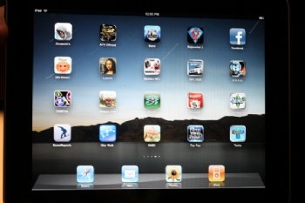



Modern Interface Applications

Slide 24
Interactive Products
Examples of hardware/software product ideas that come from interface applications development:
A mobile device that allows young children to communicate with each other and play collaborative games
A video and computer conferencing system that allows students to learn at home
An Internet application that allows the general public to access their medical records via interactive TV
A CAD system for architects and engineers
An online community that provides support for people who have a shared interest

Slide 25
Interactive Products - Use and Context of Computers
Developing interface applications must address the problems of fitting computers, their uses, and the context of use together.
Also, social organisation and work
Humans are interacting social beings
Design and development must consider models of human activity:
small groups, organisations, socio-technical systems…
quality of work life…

Slide 26
Interactive Products - Use and Context of Computers (2)
Application areas
Characteristics of application domains, e.g. individual versus group work
Popular styles for;
Document production,
Communications,
Design,
Tutorials and help,
Multi-media information kiosks,
Continuous control (Cockpits, Process Control),
Embedded systems (Copiers, Home Appliances)

Slide 27
Interactive Products - Use and Context of Computers (3)
Human-machine fit and adaptation
Improve the fit between the designed object and its use.
How systems are selected and adopted;
how users improvise routine systems;
how systems adapt to the user (Customisation);
how users adapt to the system (Training, Ease of Learning);
user guidance (Help, Documentation, Error-Handling)

Slide 28
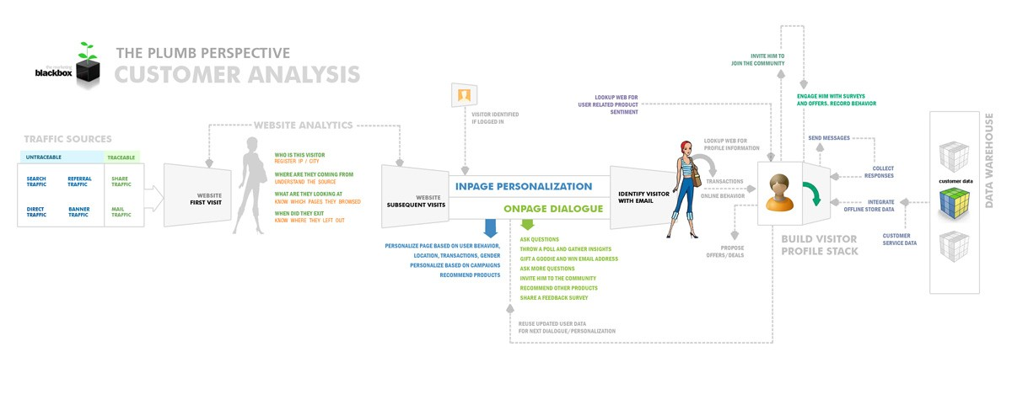
Designing and Developing Applications
It is becoming more practical to develop user interface applications for individual users (or small user groups), due to technological progress.

Slide 29
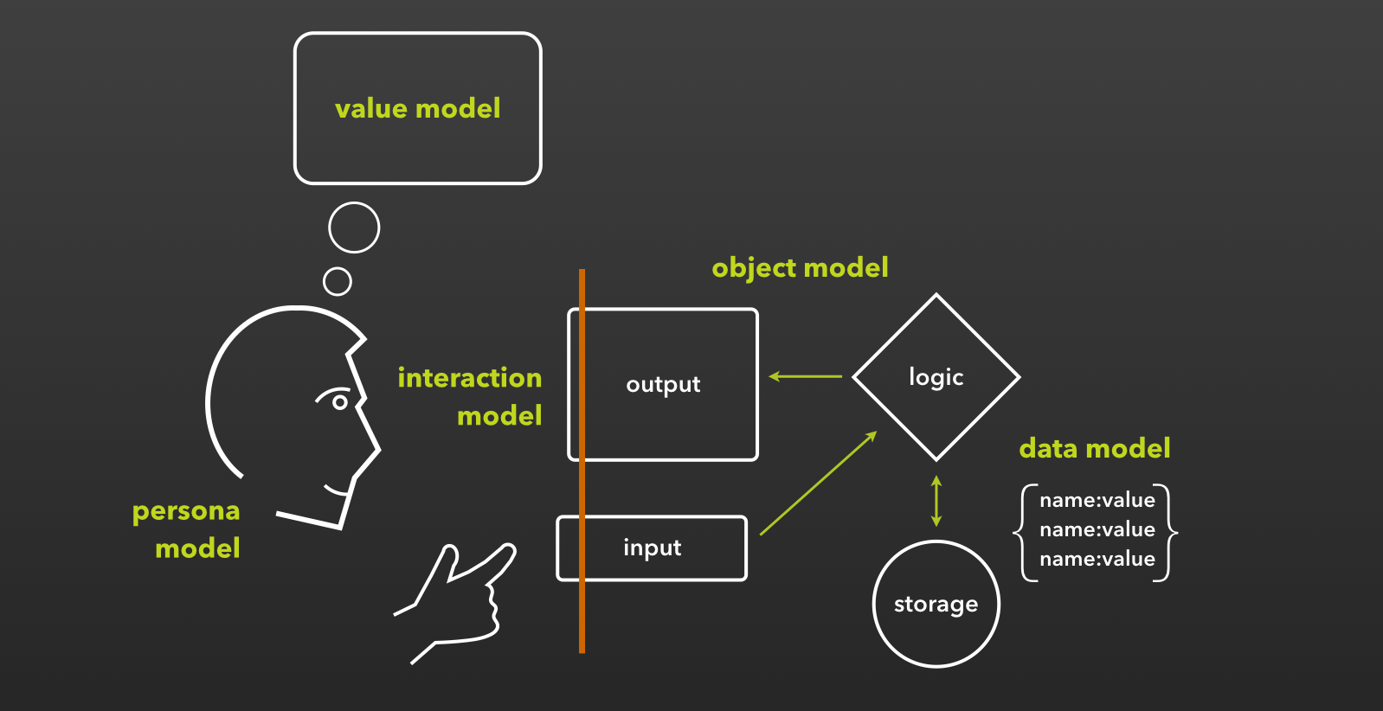
Designing and Developing Applications (2)
An example of a single persona model as a basis for an interface-oriented information system model

Slide 30
Utility and effectiveness
Utility and effectiveness are major considerations for interface applications, during design.
Utility: what services a system provides
e.g. Ability to print documents
Effectiveness: user’s ability to achieve goals, e.g.
How to enter the desired information
How to print a report
Utility and effectiveness are distinct –
A system might provide all necessary services, but if users cannot find the services items, the system lacks effectiveness

Slide 31
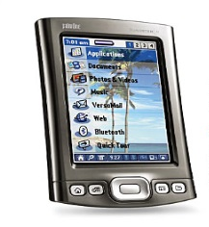
CSCW – Groupware
“Computer-supported cooperative work or CSCW is computer-assisted coordinated activity carried out by groups of collaborating individuals”
Baecker (1995)
Related Topics

Slide 32
CSCW – Groupware (2)
(CSCW - computer-supported cooperative work)
“Groupware is distinguished from normal software by the basic assumption it makes: groupware makes the user aware that he is part of a group, while most other software seeks to hide and protect users from each other... Groupware... is software that accentuates the multiple user environment, coordinating and orchestrating things so that users can “see” each other, yet do not conflict with each other.”
Baecker (1995)
Related Topics

Slide 33
Why is Groupware Becoming Important?
Form groups with common interests
Better customer service
Fewer meetings - cut down on travel costs, time and related costs
Integration of geographically disparate teams
Leveraging professional expertise
Facilitate group problem-solving
Related Topics

Slide 34

Types of CSCW
Primarily for communication
Email Structured email — computer conferencing (Netnews, newsgroups, bulletin boards) messages organised by topic, and sometimes mediated by a convener. Teleconferencing — the use of audio and video links.
Joint problem solving
Collaborative writing or drawing. Group decision support systems (GDSS) — the electronic meeting room.
Integrated systems
Where shared interpersonal communications spaces are integrated with shared task workspaces.
Related Topics

Slide 35
The Time/space Matrix
The basic matrix
Same place
Different place
Same time
Face-to-face
conversation
Telephone
Different
time
Post-it note
Letter

Slide 36
synchronous groupware
Synchronous groupware assists a group of individuals in working together at the same time.

Slide 37
Asynchronous groupware
“Asynchronous groupware supports communication and problem solving among groups of individuals who contribute at different times, and typically also are geographically dispersed.”
Baecker (1995)

Slide 38
The Time/space Matrix (2)
The CSCW matrix
One meeting site (same places)
Multiple meeting sites (different places)
Remote Interactions
Shared view desktop conferencing systems
Desktop conferencing with collaborative editors
Video conferencing
Face to Face Interactions
Public computer displays
Electronic meeting rooms
Group decision support systems
Synchronous
communication (same time)
Communication and Coordination
Asynchronous conferencing Bulletin boards
Version control
Meeting schedulers
Ongoing Tasks
Team rooms
Group displays
Shift work groupware
Project management
Asynchronous communication (different time)

Slide 39
Design Issues
Multiple users
Different kinds of conversation
Supporting co-ordination mechanisms
Supporting awareness
Support for innovation
Social protocols and organisational issues
Balance of control
Enabling customisation

Slide 40
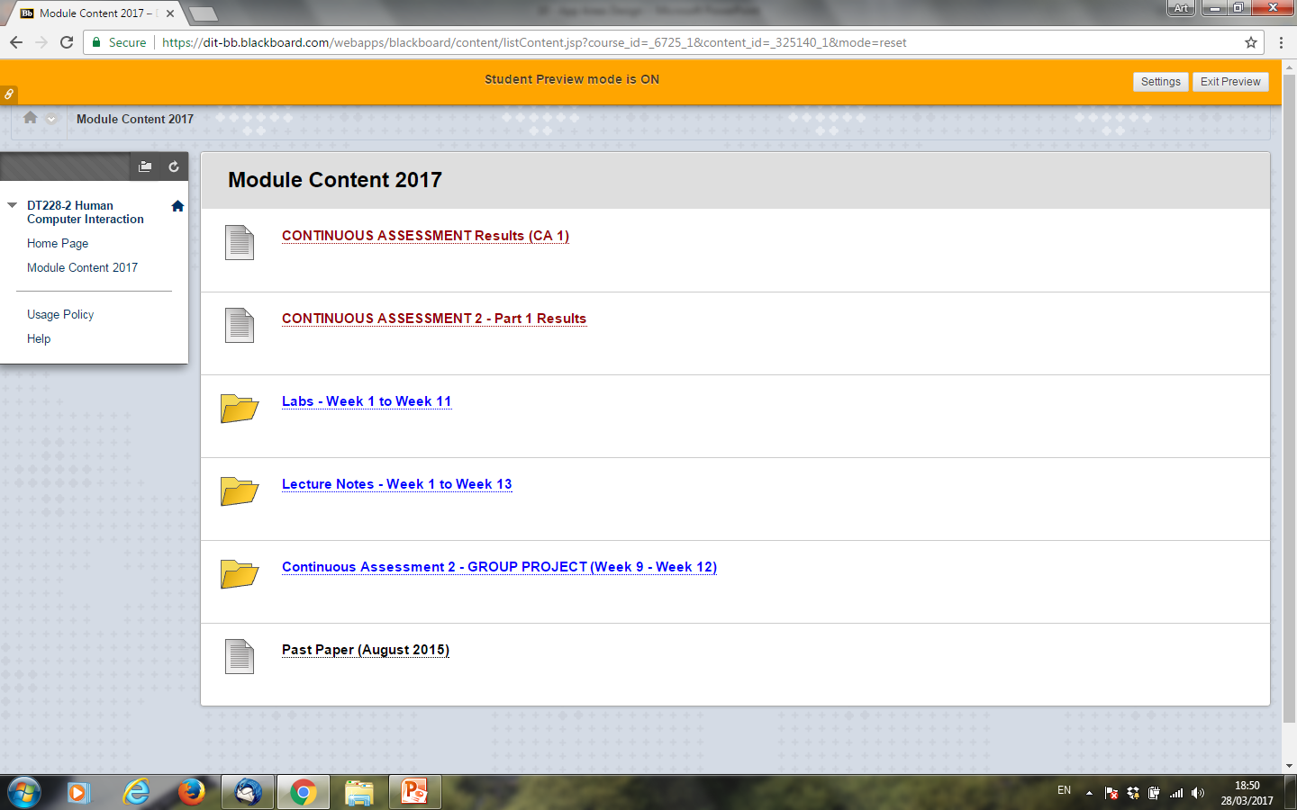
Fill up the Time/Space Matrix with WebCourses Features

Slide 41
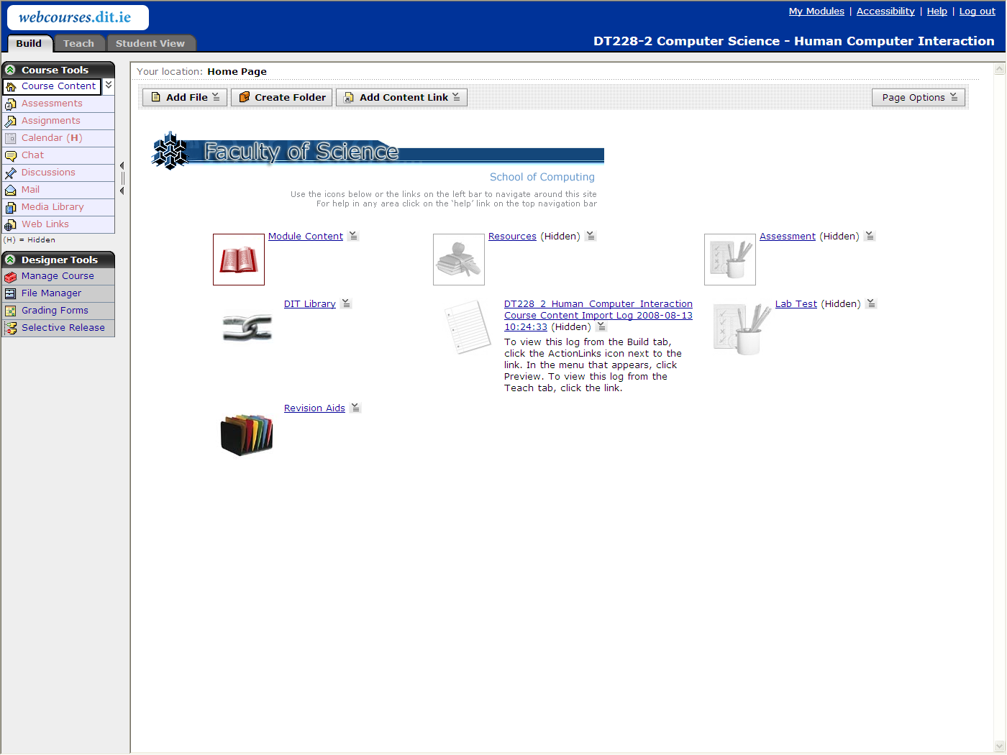
Fill up the Time/Space Matrix with WebCourses Features (2)

Slide 42
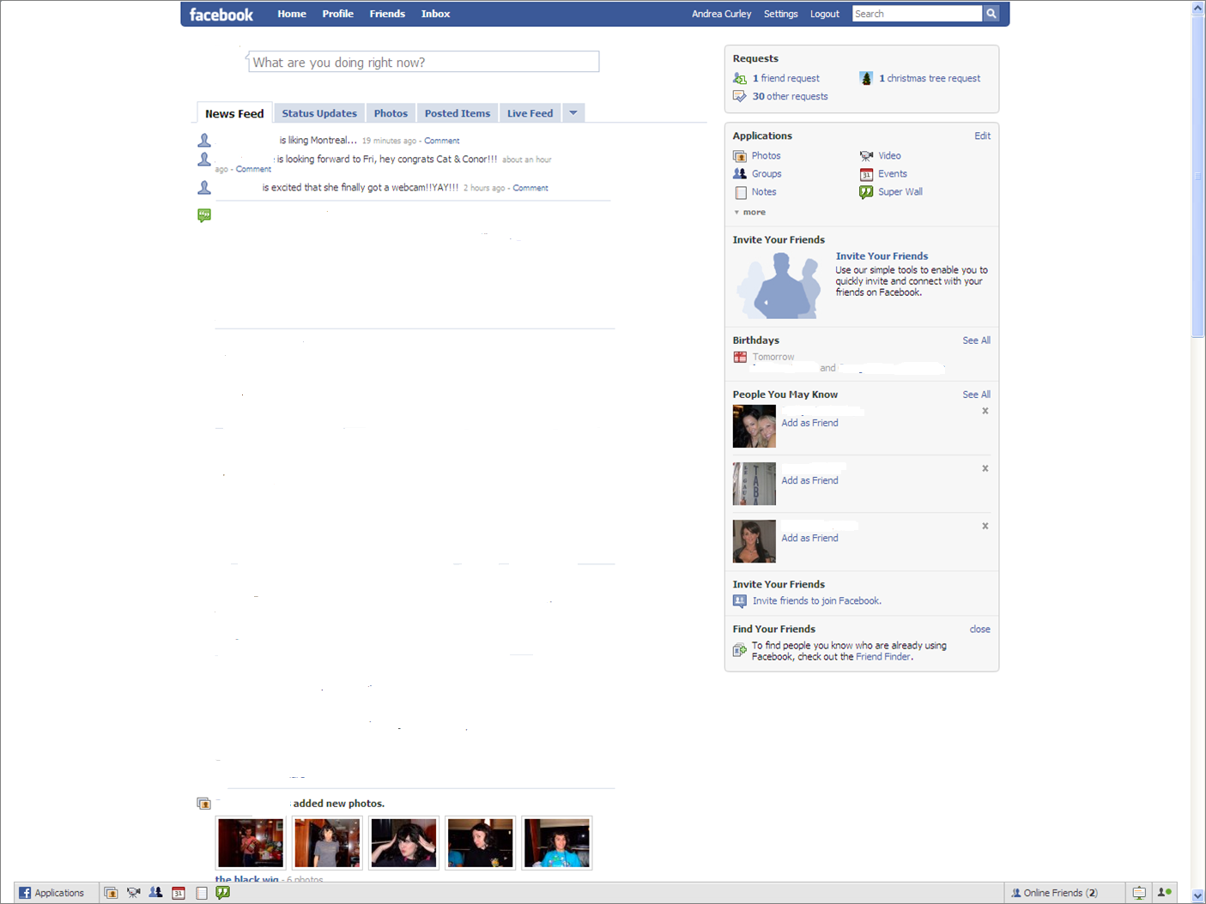
Fill up the Time/Space Matrix with Facebook Features

Slide 43
Challenges for CSCW Developers
GRUDIN’S EIGHT CHALLENGES
Challenge 1: The disparity between who does the work and who gets benefit
Problem: Costs and benefits from using groupware are often distributed unevenly. Principal beneficiaries are often the purchase decision makers/management; but others have to carry out bulk of work without clear motivation.
Examples: meeting scheduling, voice annotation.
Solution: create benefits for all group members during design stage.

Slide 44
Challenges for CSCW Developers (2)
Challenge 2: Critical mass and prisoner’s dilemma problems
Problem: Groupware is only useful if most group member utilise it – more stringent requirement than for individual software. If individuals prefer lurking/freeloading, groupware the app will ultimately fail.
Solution: Build in use incentives, emphasize individual/group benefits (vague).

Slide 45
Challenges for CSCW Developers (3)
Challenge 3: Social, political and motivational factors
Problem: Groupware has to fit into an implicit framework of social group interaction. Not all processes can be represented explicitly without violating taboos.
Example: Meeting scheduling
Solution: Do not assume a completely rational work environment. Understand the subtleties of the target environment. Work with representative users.

Slide 46
Challenges for CSCW Developers (4)
Challenge 4: Exception handling in workgroups
Problem: Groupware has to adapt to/enable ad hoc problem solving and improvisation; post hoc rule-based systems are too rigid and brittle. In reality, decoupling of rules and actual work patterns is pervasive - this allows for flexibility and localised judgment.
Solution: Learn how work is really done.

Slide 47
Challenges for CSCW Developers (5)
Challenge 5: Designing for infrequently used features
Problem: “To a hammer, everything looks like a nail”: group communication may be infrequent.
Solution:
Integrate group features with individual activity
Design should be unobtrusive yet accessible
Add groupware features to already existing applications (e.g., MS Office)

Slide 48
Challenges for CSCW Developers (6)
Challenge 6: The underestimated difficulty of evaluating groupware
Problem: Group context introduces social, motivational, economic, political dynamics that are hard to measure. Lab situations and prototypes are often ineffective. Because of a lack of definitive studies, the same mistakes are repeated over and over again.
Solution: Grudin does not know.

Slide 49
Challenges for CSCW Developers (7)
Challenge 7: The breakdown of intuitive decision-making
Problem: Developers cannot rely on their own individual informed intuition when group processes are concerned. Nor can any other resource inside the development environment help out. Too many applications target managers, neglecting to accommodate other users – results in resistance.
Solution: Involve real users early on in the design process.

Slide 50
Challenges for CSCW Developers (8)
Challenge 8: Managing acceptance, a new challenge for product developers
Problem: Most CSCW software is shrink-wrapped – developers are removed from system acceptance issues – this needs to be overcome.
Solution: Learn from Information Systems; cooperate with marketers; package software with consulting services (Lotus Notes).

Slide 51
Summary of the Lecture
Interactive Systems Development
Interactive Applications – how they relate to HCI
Historical view of User Interface Applications Development
Aspects of modern interface-oriented applications
Computer-supported cooperative work or CSCW is computer-assisted coordinated activity carried out by groups of collaborating individuals
Time/Space Matrix and CSCW
Grudin’s eight challenges for CSCW developers

Slide 52
References
Abowd, G. & Mynatt, E. (2000) Charting Past, Present and Future Research in Ubiquitous Computing
Baecker, R. M., et al (1995) Readings in Human-Computer Interaction: Towards the Year 2000
Bannon, L. (1992) Perspectives on CSCW: From HCI and CMC to CSCW
Benyon, D. et al (2005) Designing Interactive Systems
Alan Dix et al (1993) Human Computer Interaction
Grudin, J. (1994) CSCW: History and Focus

Slide 53
References
Grudin, J. (1994) Groupware and Social Dynamics: Eight Challenges for Developers
Gupta, S. & Kaiser, G. (2004) A Virtual Environment for Collaborative Distance Learning With Video Synchronization
Ishii, H. (2004) Bringing clay and sand into digital design – continuous tangible user interfaces
Milgram & Kishino (1994) A Taxonomy of Mixed Reality Visual Display
Scholtz, J. (2001) Ubiquitous Computing Goes Mobile
Weiser, M. (1991) The Computer for the 21st Century

